Slide 1
Improving Scalability of Bundle Adjustment
Partha Ghosh
Master Thesis
Supervised by: Thomas Schneider, Marcin Dymczyk

Slide 2
Agenda
Bundle Adjustment
  Motivation
  Keyframing
CKLAM
  Formulation
  Sparsity
  Results
R-CKLAM
  Formulation
  Results

Slide 3
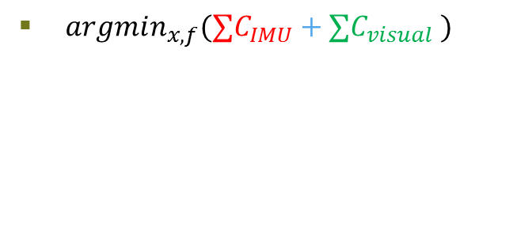




Bundle Adjustment in SLAM
$argmin_{x,f}(∑C_{IMU}+∑C_{visual} )$
$$x_{1}$$
$$x_{m}$$
Exclude redundant information
$$x_{1}$$
$$x_{m}$$

Slide 4
Agenda
Bundle Adjustment
  Motivation
  Keyframing
CKLAM
  Formulation
  Sparsity
  Results
R-CKLAM
  Formulation
  Results

Slide 5
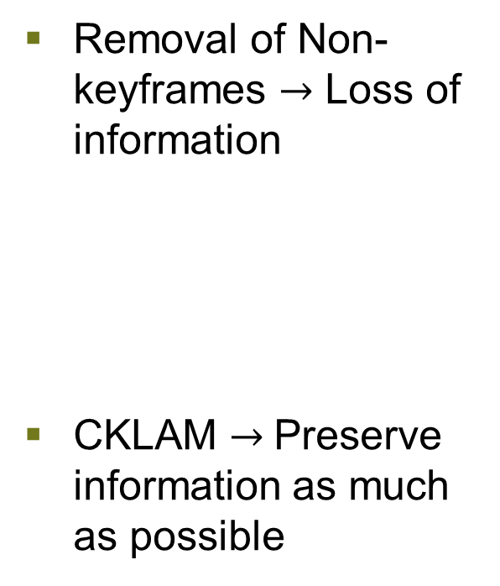
Constrained Keyframe-Based Localization and Mapping (CKLAM)
Removal of Non-keyframes $→$ Loss of information
CKLAM $→$Preserve information as much as possible

Slide 6

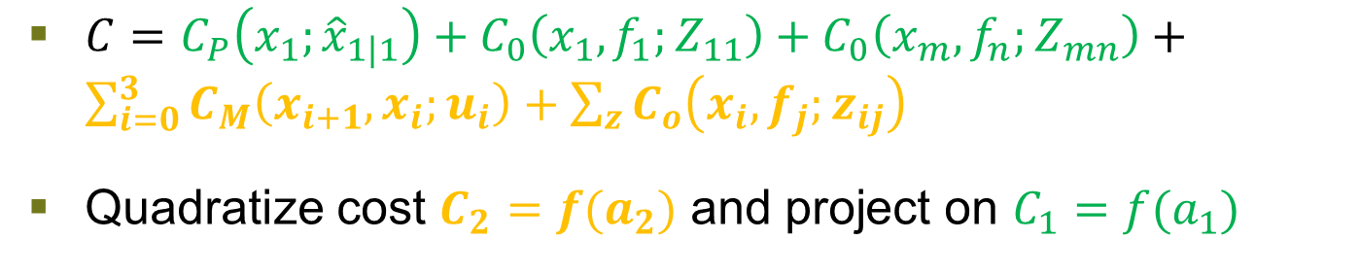





CKLAM Formulation
$$f_{n}$$
$$f_{1}$$
$$Z_{11}$$
$$Z_{mn}$$
$$x_{1}$$
$$x_{m}$$
$C=C_{P}\left(x_{1};{\hat{x}}_{1|1}\right)+C_{0}\left(x_{1}, f_{1};Z_{11}\right)+C_{0}\left(x_{m}, f_{n};Z_{mn}\right)+\sum_{i=0}^{3}{C_{M}\left(x_{i+1}, x_{i};u_{i}\right)}+\sum_{z}{C_{o}\left(x_{i}, f_{j};z_{ij}\right)}$
Quadratize cost $C_{2}=f(a_{2})$ and project on $C_{1}=f(a_{1})$
[1]

Slide 7
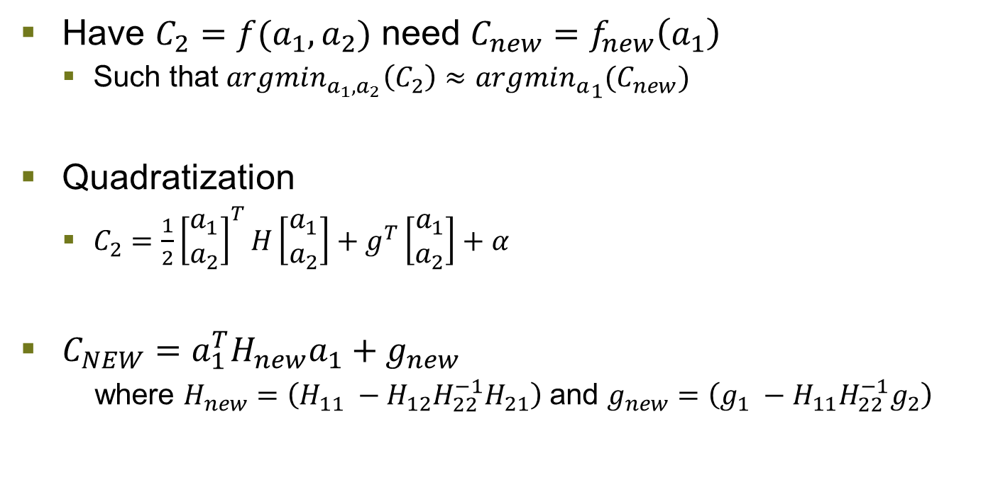
CKLAM Objective Simplified
Have $C_{2}=f(a_{1}, a_{2})$ need $C_{new}=f_{new}\left(a_{1}\right)$
  Such that $argmin_{a_{1},a_{2}}\left(C_{2}\right)≈argmi{n_{a}}_{1}(C_{new})$
Quadratization
  $C_{2}=\frac{1}{2}{\left[\begin{matrix}a_{1} \\ a_{2}\end{matrix}\right]}^{T}H\left[\begin{matrix}a_{1} \\ a_{2}\end{matrix}\right]+g^{T}\left[\begin{matrix}a_{1} \\ a_{2}\end{matrix}\right]+α$
$C_{NEW}=a_{1}^{T}H_{new}a_{1}+g_{new}$
  where $H_{new}=\left(H_{11} −H_{12}H_{22}^{−1}H_{21}\right)$ and $g_{new}=\left(g_{1} −H_{11}H_{22}^{−1}g_{2}\right)$

Slide 8
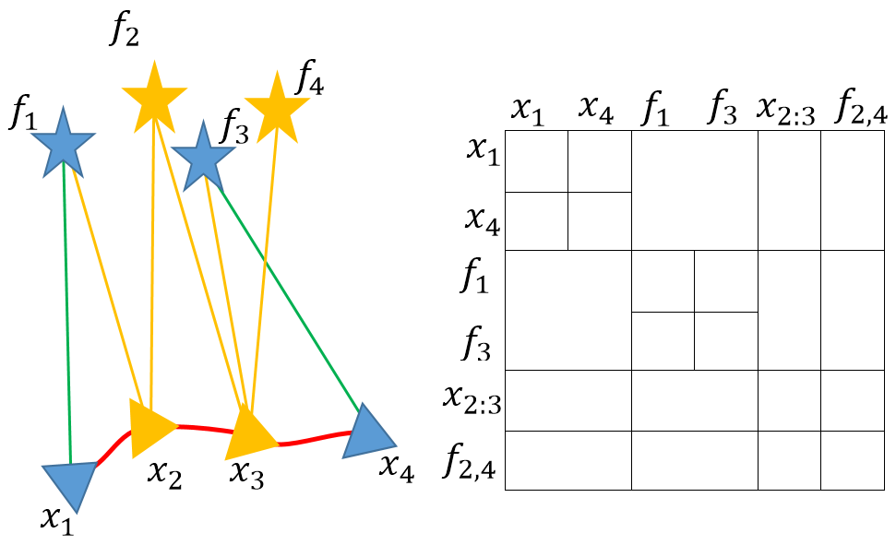

Hessian Matrix for Bundle Adjustment
$$H_{C_{2}}=$$

Slide 9
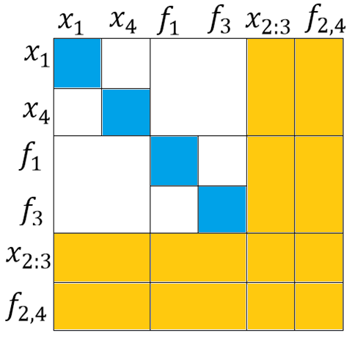
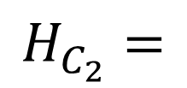
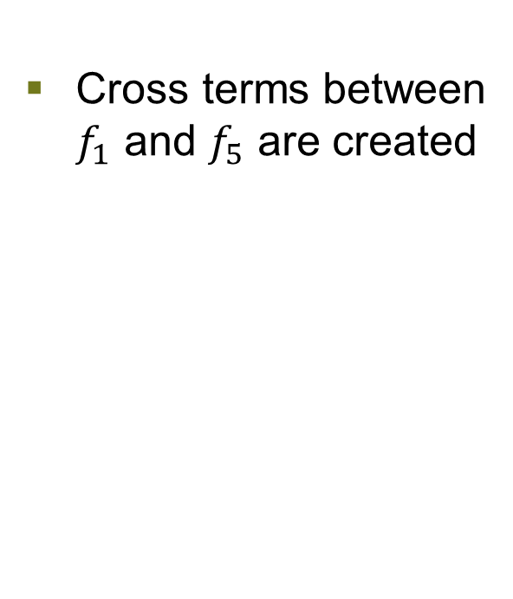

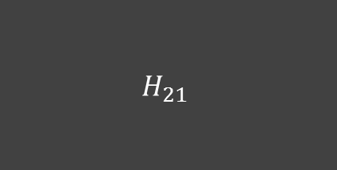


CKLAM Sparsity
Cross terms between $f_{1}$ and $f_{5}$ are created
$$H_{11}$$
$$H_{12}$$
$$H_{C_{2}}=$$
$$H_{21}$$
$$H_{22}$$

Slide 10
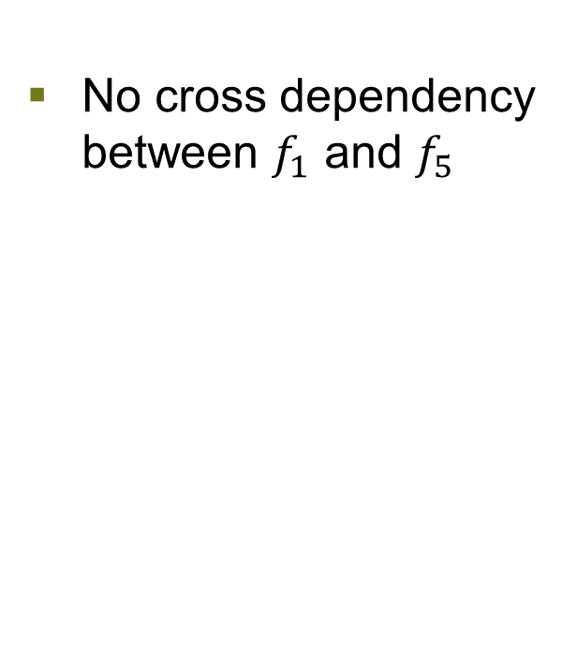




CKLAM Sparsity
No cross dependency between $f_{1}$ and $f_{5}$
$$H_{11}$$
$$H_{12}$$
$$H_{21}$$
$$H_{22}$$
$$H_{C_{2}}=$$

Slide 11
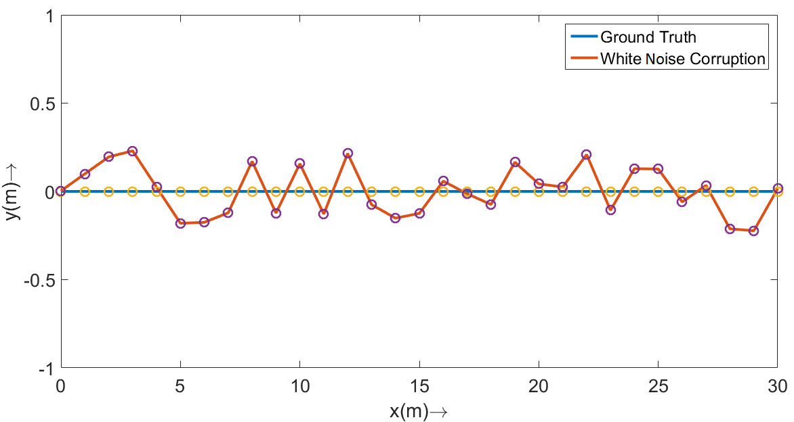
CKLAM Results (Simulated Map)

Slide 12
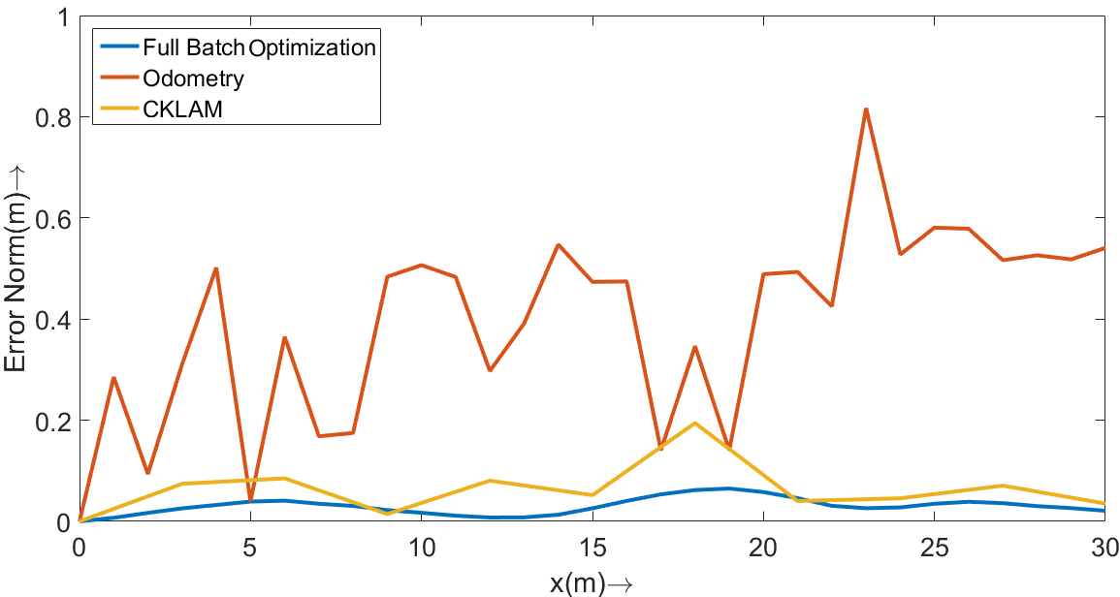
CKLAM vs Bundle Adjustment

Slide 13
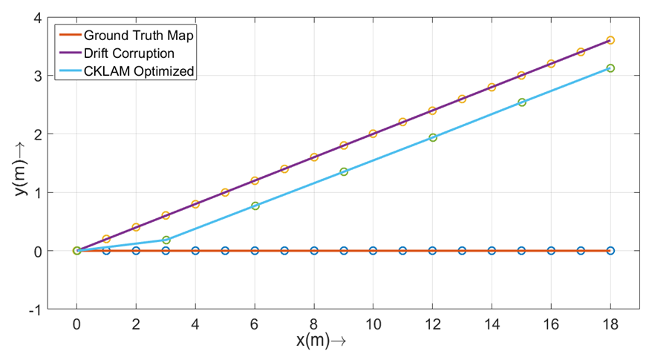
CKLAM Results

Slide 14
Agenda
Bundle Adjustment
  Motivation
  Keyframing
CKLAM
  Formulation
  Sparsity
  Results
R-CKLAM
  Formulation
  Results

Slide 15
Relative CKLAM (RCKLAM) Motivation
Modeling integrated error as absolute Gaussian is unnatural
No substantial changes of individual vertices
Hard to move local information to global frame
CKLAM
RCKLAM
Model uncertainty of relative pose between consecutive key frames
Notes:
VIO is relative à marginalized keyframes contain information about relative transformation
o CKLAM formulated in the global frame can’t handle LC
o R-CKLAM fixes that by …

Slide 16

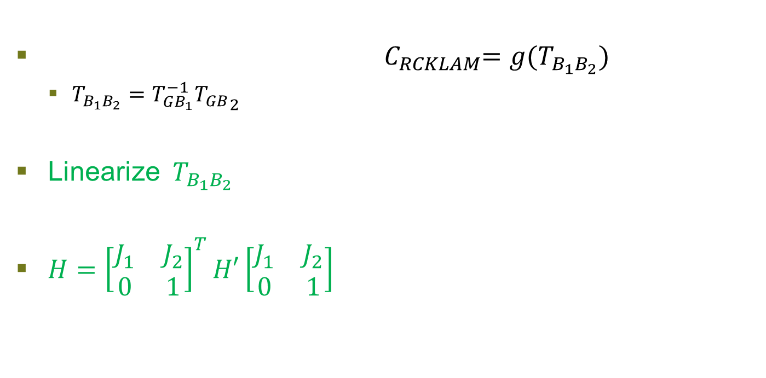
RCKLAM Formulation
${ C}_{RCKLAM}=g(T_{B_{1}B_{2}})$
  $T_{{B_{1}B}_{2}}=T_{GB_{1}}^{−1}{T_{GB}}_{2 }$
Linearize${ T}_{{B_{1}B}_{2}}$
$H={\left[\begin{matrix}J_{1} & J_{2} \\ 0 & 1\end{matrix}\right]}^{T}H′\left[\begin{matrix}J_{1} & J_{2} \\ 0 & 1\end{matrix}\right]$
$$C_{CKLAM}=f\left(T_{GB_{1}}, {T_{GB}}_{2 }\right) →$$

Slide 17
R-CKLAM vs CKLAM
CKLAM
R-CKLAM

Slide 18
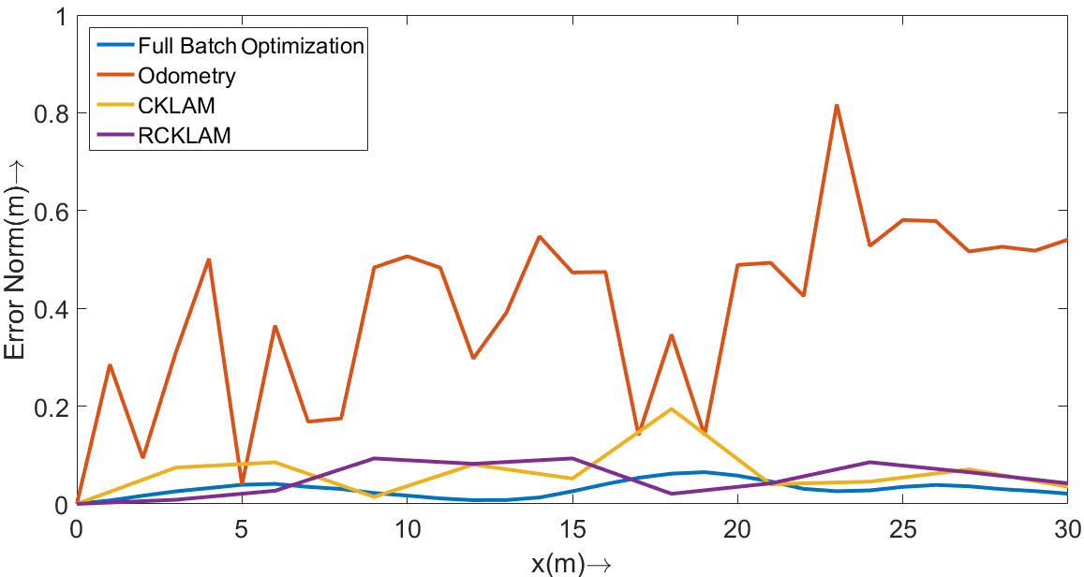
RCKLAM vs CKLAM (Simulated Map)

Slide 19
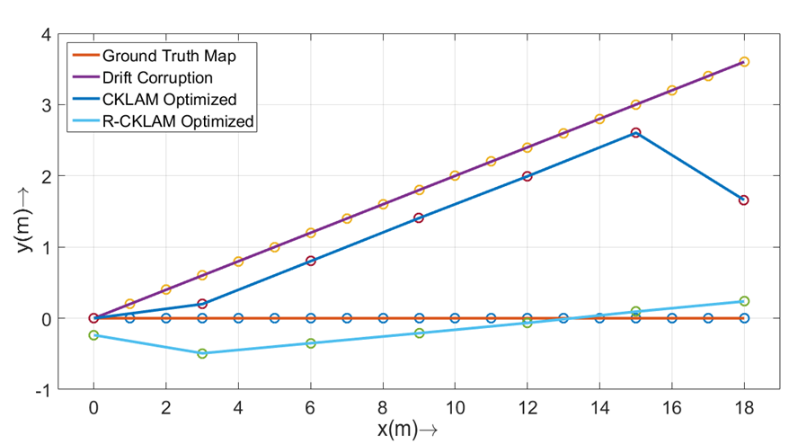
RCKLAM and Loop-closure

Slide 20
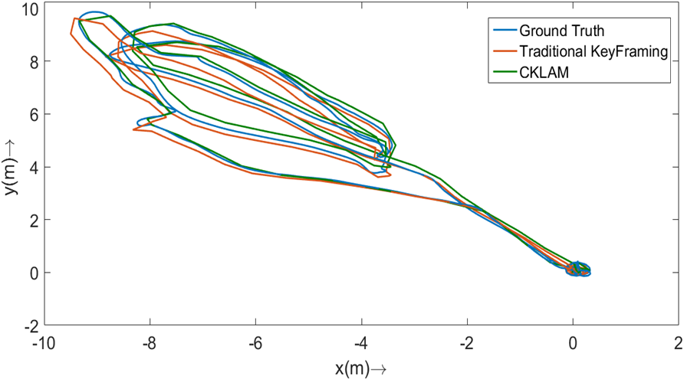
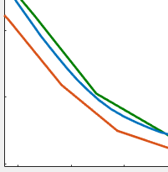
Evaluation on Euroc Datasets

Slide 21
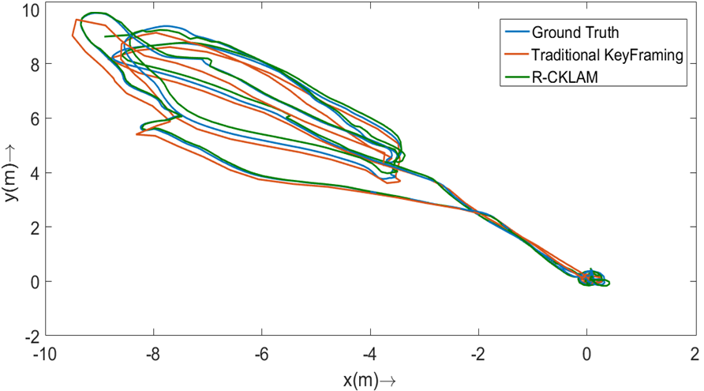
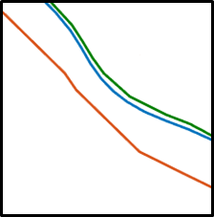
Evaluation on Euroc Datasets

Slide 22
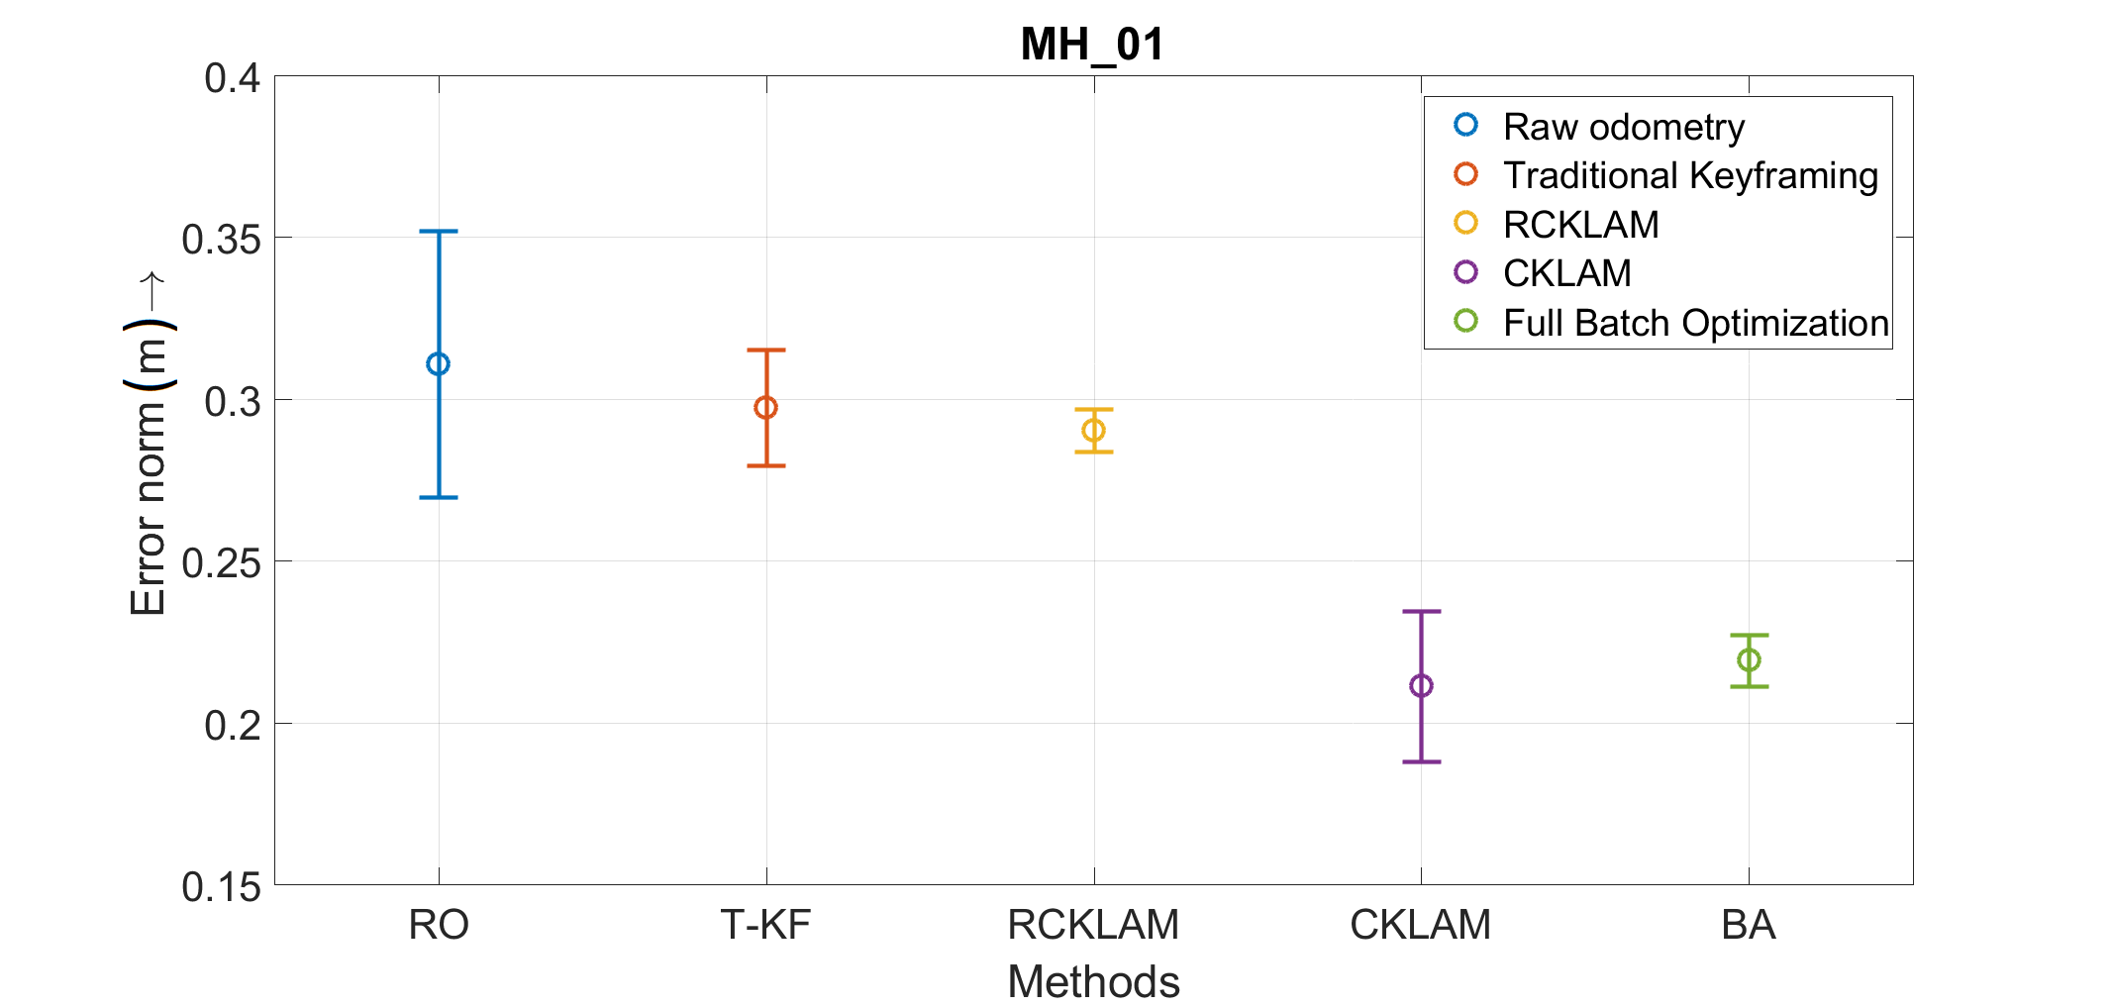
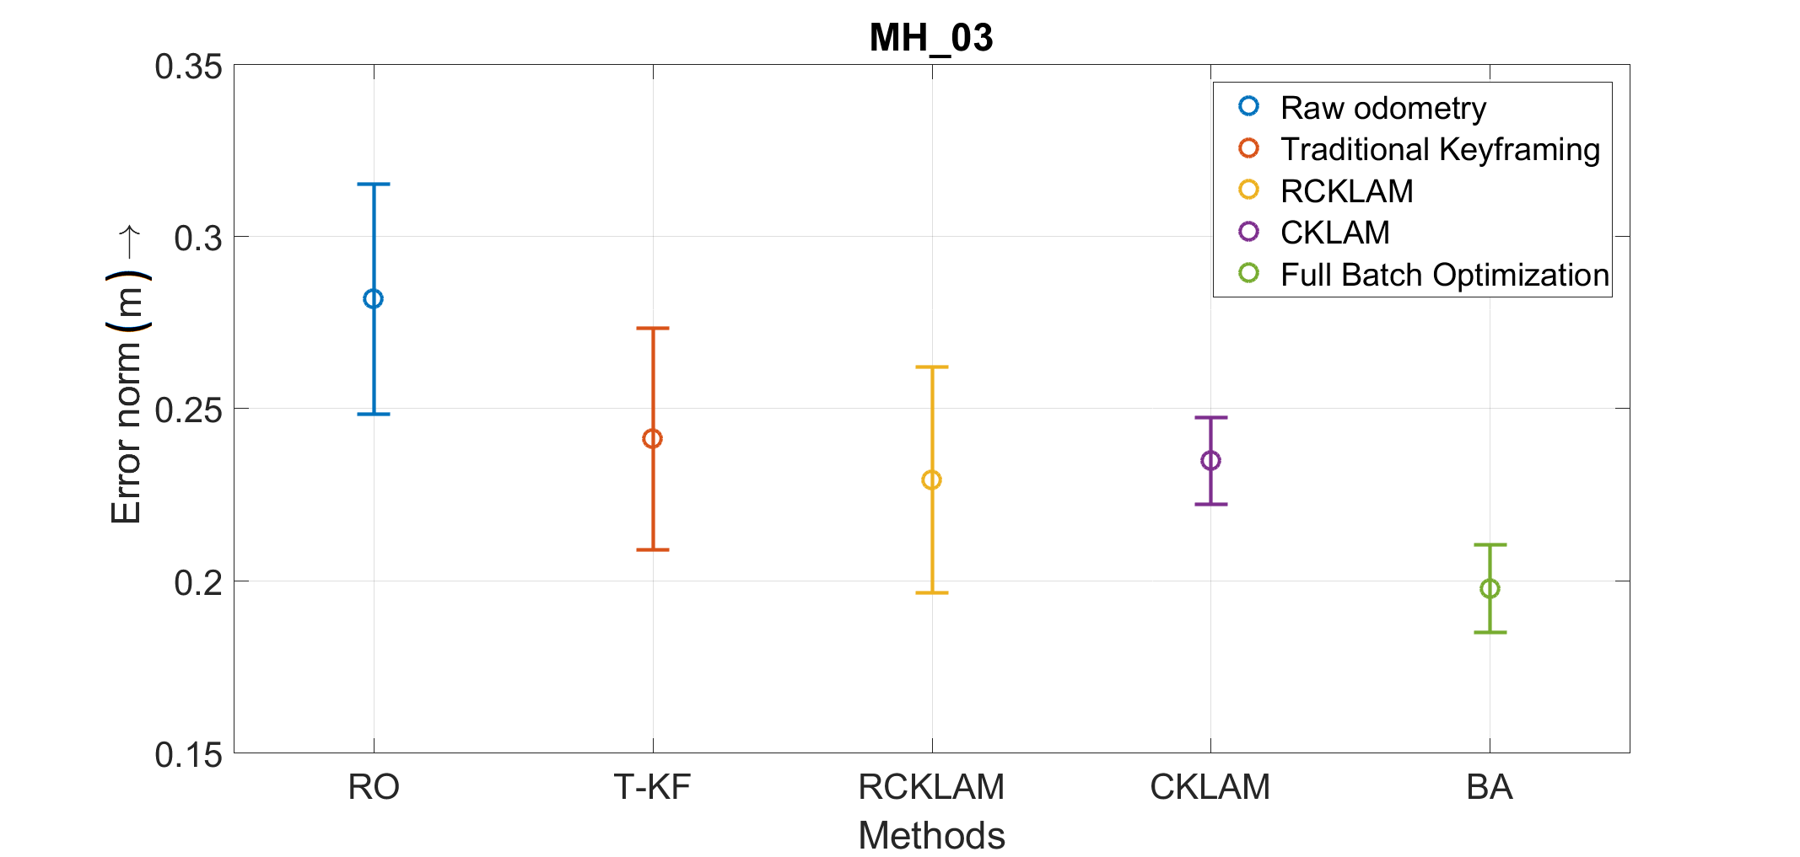
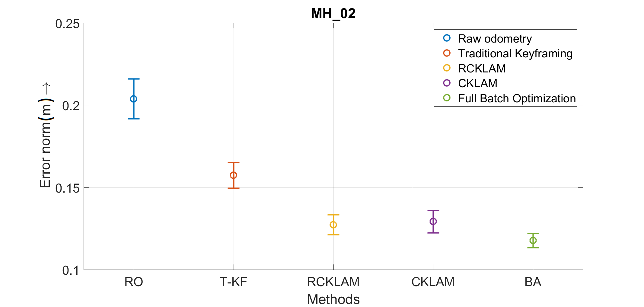
Results Real Maps

Slide 23
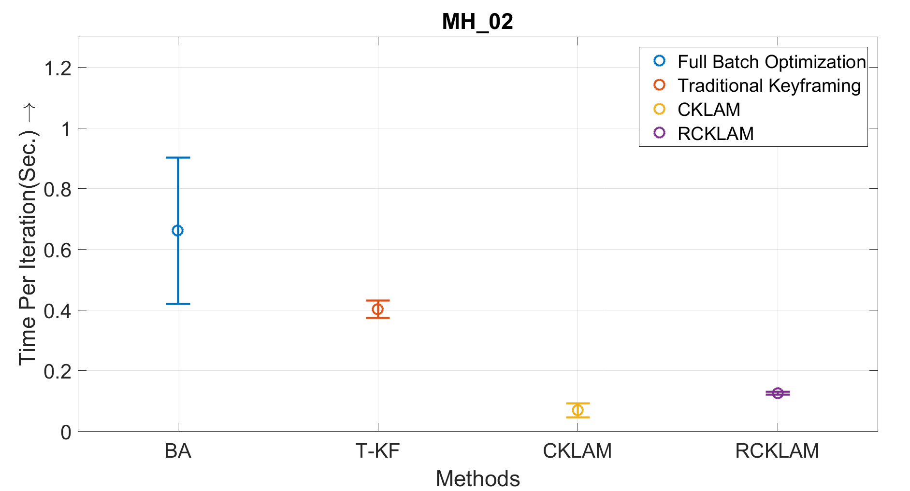
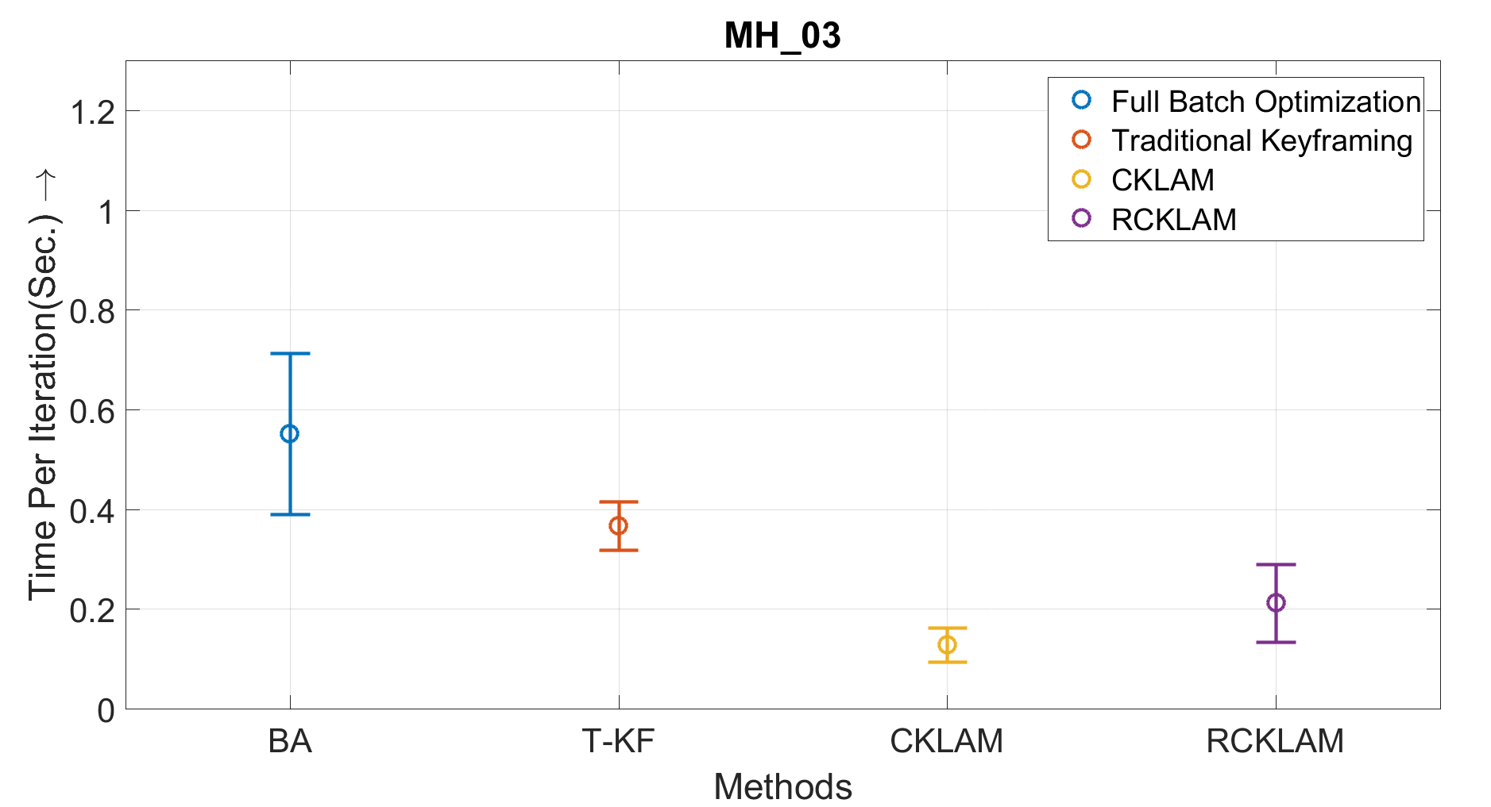

Computational time advantage (Only Optimization time)
Notes:
MH03 - Selected 160 keyframes of 667 vertices.
MH02 - Selected 104 keyframes of 752 vertices.
MH01 - Selected 122 keyframes of 913 vertices.

Slide 24
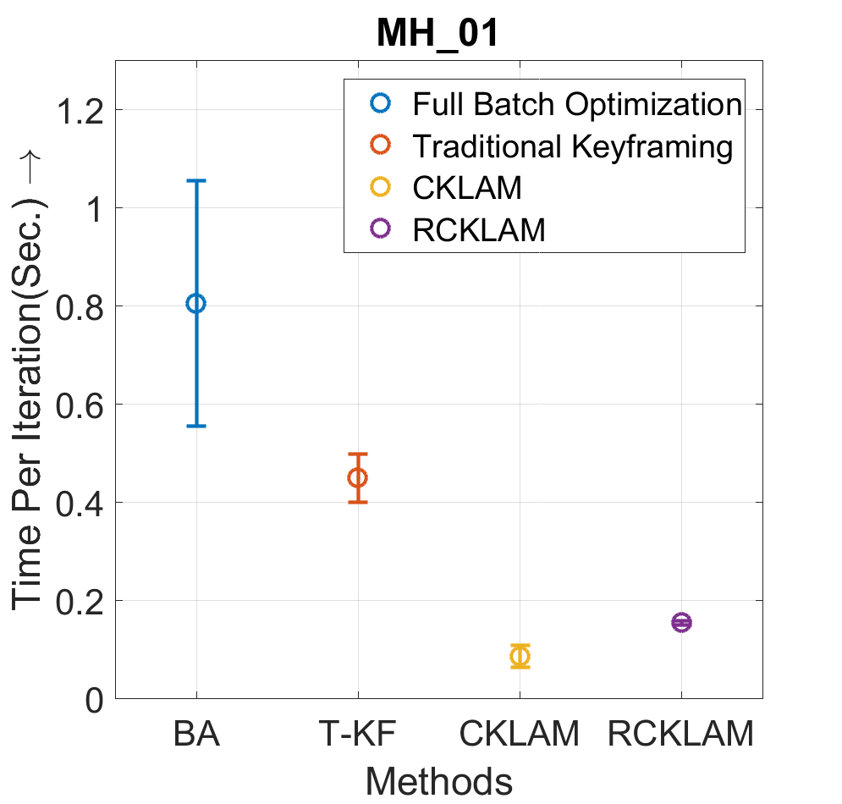
Conclusion
A new method R-CKLAM has been proposed
Flexibility significantly improved
Advantages with loop closure shown
Future Work
Building online versions of CKLAM and RCKLAM
Keyframe selection coupled with CKLAM

Slide 25
References
1. Esha D. Nerurkar , Kejian J. Wu , and Stergios I. Roumeliotis , “C-KLAM: Constrained Keyframe-Based Localization and Mapping”, In IEEE International Conference on Robotics and Automation Workshop on Long-term Autonomy, 2013.
2. G. Klein and D. Murray. Parallel tracking and mapping for small AR workspaces. In Proc. of the IEEE and ACM International Symposium on Mixed and Augmented Reality, pages 225–234, Nara, Japan, Nov. 13–16 2007.
3. J. Folkesson and H. Christensen, “Graphical slam - a self-correcting map,” in Proc. of the IEEE International Conference on Robotics and Automation, New Orleans, LA, Apr. 26 – May 1, 2004, pp. 383–390.

Slide 26
CKLAM Marginalization
[1]

Slide 27
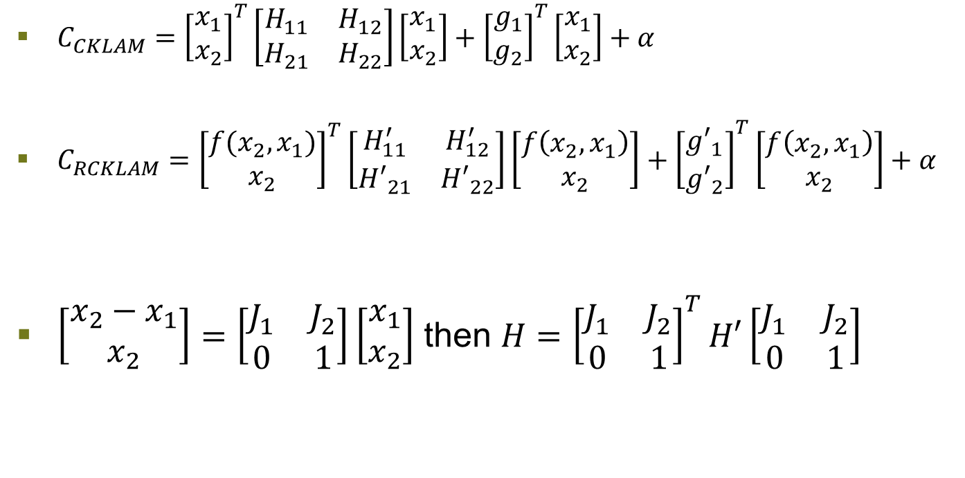
RCKLAM Formulation
  $C_{CKLAM}={\left[\begin{matrix}x_{1} \\ x_{2}\end{matrix}\right]}^{T}\left[\begin{matrix}H_{11} & H_{12} \\ H_{21} & H_{22}\end{matrix}\right]\left[\begin{matrix}x_{1} \\ x_{2}\end{matrix}\right]+{\left[\begin{matrix}g_{1} \\ g_{2}\end{matrix}\right]}^{T}\left[\begin{matrix}x_{1} \\ x_{2}\end{matrix}\right]+α$
  $C_{RCKLAM}={\left[\begin{matrix}{{f(x}_{2}, x}_{1}) \\ x_{2}\end{matrix}\right]}^{T}\left[\begin{matrix}H_{11}^{′} & H_{12}^{′} \\ {H′}_{21} & {H′}_{22}\end{matrix}\right]\left[\begin{matrix}f\left(x_{2}, x_{1}\right) \\ x_{2}\end{matrix}\right]+{\left[\begin{matrix}{g′}_{1} \\ {g′}_{2}\end{matrix}\right]}^{T}\left[\begin{matrix}f\left(x_{2},x_{1}\right) \\ x_{2}\end{matrix}\right]+α$
$\left[\begin{matrix}{x_{2}−x}_{1} \\ x_{2}\end{matrix}\right]=\left[\begin{matrix}J_{1} & J_{2} \\ 0 & 1\end{matrix}\right]\left[\begin{matrix}x_{1} \\ x_{2}\end{matrix}\right]$ then $H={\left[\begin{matrix}J_{1} & J_{2} \\ 0 & 1\end{matrix}\right]}^{T}H′\left[\begin{matrix}J_{1} & J_{2} \\ 0 & 1\end{matrix}\right]$

Slide 28
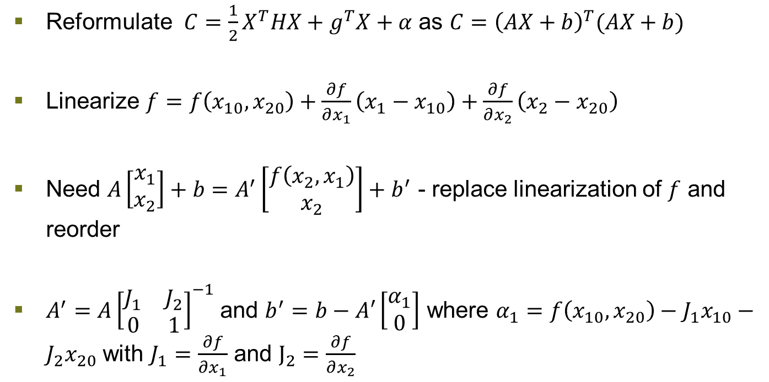
RCKLAM Formulation
  Reformulate $C=\frac{1}{2}X^{T}HX+g^{T}X+α$ as $C={\left(AX+b\right)}^{T}(AX+b)$
  Linearize $f=f\left(x_{10},x_{20}\right)+\frac{∂f}{∂x_{1}}\left(x_{1}−x_{10}\right)+\frac{∂f}{∂x_{2}}\left(x_{2}−x_{20}\right)$
  Need $A\left[\begin{matrix}x_{1} \\ x_{2}\end{matrix}\right]+b=A^{′}\left[\begin{matrix}f\left(x_{2}, x_{1}\right) \\ x_{2}\end{matrix}\right]+b^{′}$ - replace linearization of $f$ and reorder
  $A^{′}=A{\left[\begin{matrix}J_{1} & J_{2} \\ 0 & 1\end{matrix}\right]}^{−1}$ and $b^{′}=b−A′\left[\begin{matrix}α_{1} \\ 0\end{matrix}\right]$ where $α_{1}=f\left(x_{10},x_{20}\right)−J_{1}x_{10}−J_{2}x_{20}$ with $J_{1}=\frac{∂f}{∂x_{1}}$ and $J_{2}=\frac{∂f}{∂x_{2}}$

Slide 29
Results Real Maps (MH - 01)

Slide 30
Results Real Maps (MH - 01)

Slide 31
Results Real Maps (MH - 02)

Slide 32
Results Real Maps (MH - 02)

Slide 33
Results Real Maps (MH - 03)

Slide 34
Results Real Maps (MH - 03)

Slide 35
Results Real Maps (MH - 01)

Slide 36
Results Real Maps (MH - 01)

